Slide 1
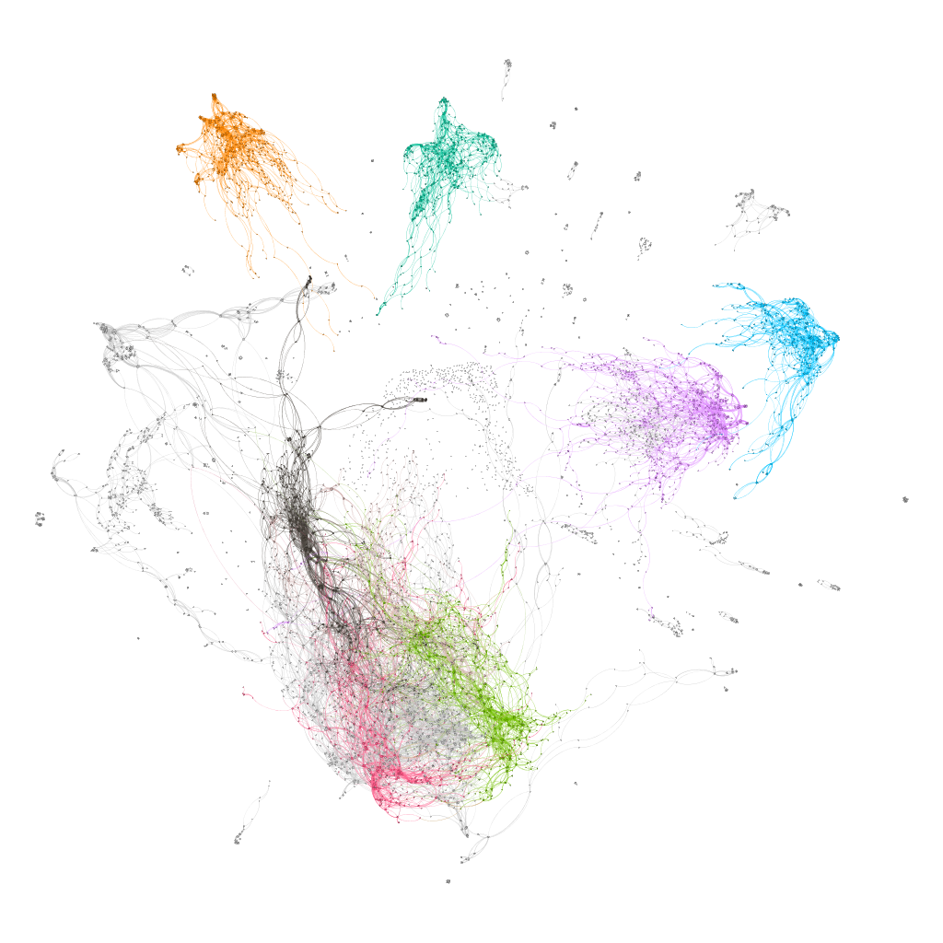
pcsPy: a python utility for generalized pitch class set classification and analysis
Marco Buongiorno Nardelli
CEMI – Center for experimental Music and Intermedia
iARTA – Initiative for Advanced Research in Technology and the Arts
Department of Physics
University of North Texas

Slide 2
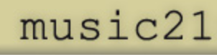
pcsPy components
The PCSet class:
pcs operations generalized to arbitrary temperament:
Transpose
Inverse
Normal order
Prime form
Interval vector
LISV vector
pcs names
…etc.
Network and graph analysis functions:
Dictionary of pcs with arbitrary cardinality
Network construction with user-defined metric (distance)
Interval vector networks
Voice leading networks
ego-networks
… etc.

Slide 3
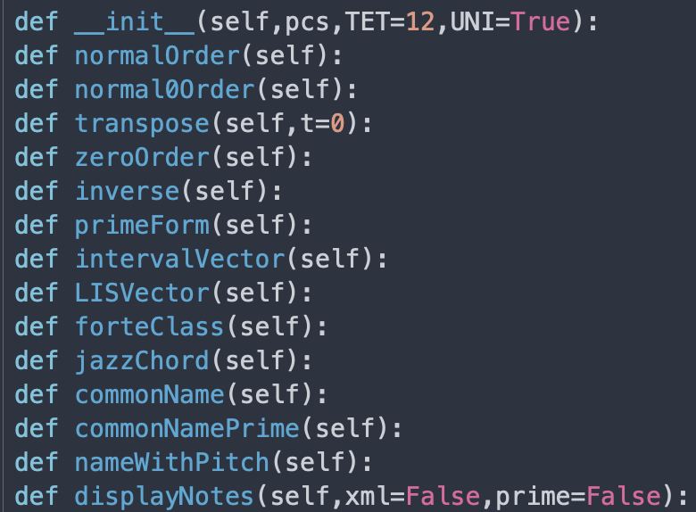
PCSet class
The PCSet class:

Slide 4
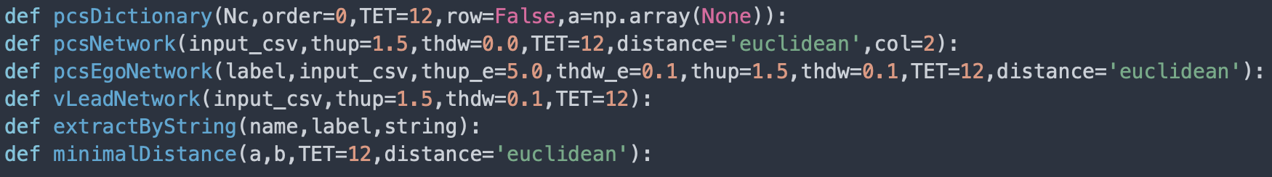
Network functions
Network and graph analysis functions:
Distance as metric in the musical space
Euclidean distance: ordinary straight line distance between two points in the chosen musical space (Pythagoras theorem)
interval vector (IV) distance: IVs are naturally ordered and their distance can be calculated directly
voice leading distance: minimal distance between pcs of same cardinality
Two different representations of the musical space!

Slide 5
Dictionaries
Generalized dictionary of pcs for arbitrary (equal) temperament – universal classification

Slide 6
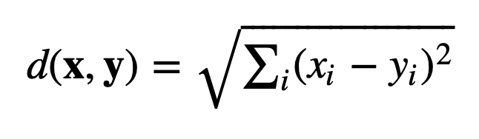
Topology in the interval vector space
operator | distance | weight
O(1) | 1.0000 | 1.0000
O(1,1) | 1.4142 | 0.7071
O(1,1,1) | 1.7321 | 0.5774
O(2) | 2.0000 | 0.5000
O(1,1,1,1) | 2.0000 | 0.5000
O(1,2) | 2.2361 | 0.4472
1+1+1+1+1 | 2.2361 | 0.4472
2+1+1 | 2.4494 | 0.4083
1+1+1+1+1+1 | 2.4495 | 0.4082
2+1+1+1 | 2.6457 | 0.3780
2+1+1+1+1 | 2.8284 | 0.3536
2+2 | 2.8284 | 0.3536
2+1+1+1+1+1 | 3.0000 | 0.3333
2+2+1 | 3.0000 | 0.3333
3 | 3.0000 | 0.3333
1+3 | 3.1622 | 0.3162
2+1+1+1 | 3.1622 | 0.3162
1+1+3 | 3.3166 | 0.3015
1+1+1+2 | 3.4641 | 0.2887
2+3 | 3.6056 | 0.2774
1+2+3 | 3.7416 | 0.2673
4 | 4.0000 | 0.2500
More on distances:
Weight = 1/distance
Operator: how many elements are changed by n integers O(1,1,2) = two elements are raised or lowered by 1, one is raised or lowered by 2
Operators must have dimensions ≤ dim(IntervalVector) ≡ TET/2

Slide 7
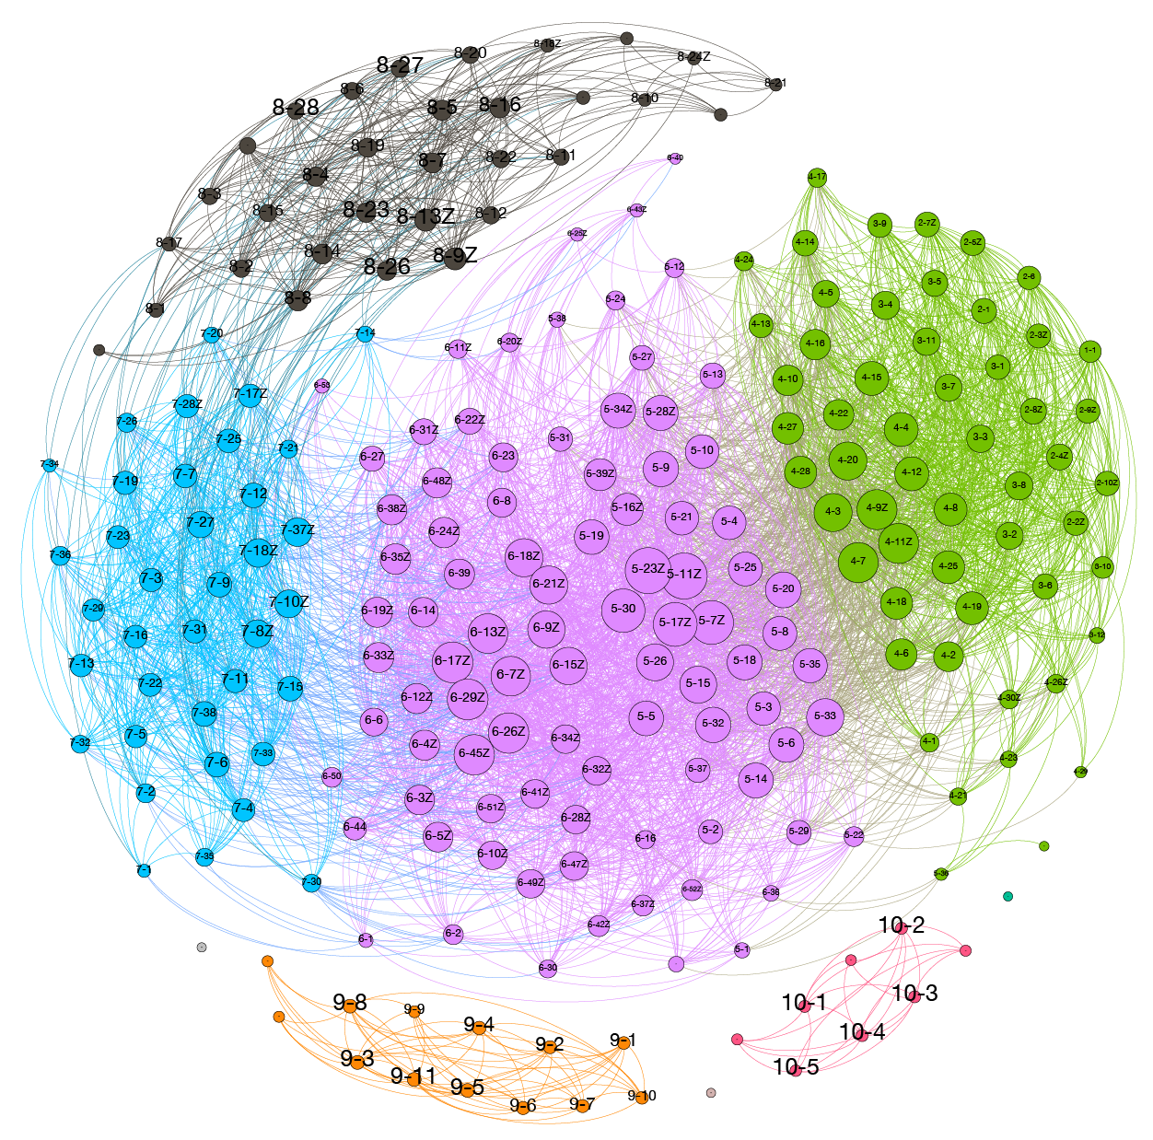
Topology of the 12TET pcs space
Classification based on distances between IVs
Nodes are connected for distances up to 4

Slide 8
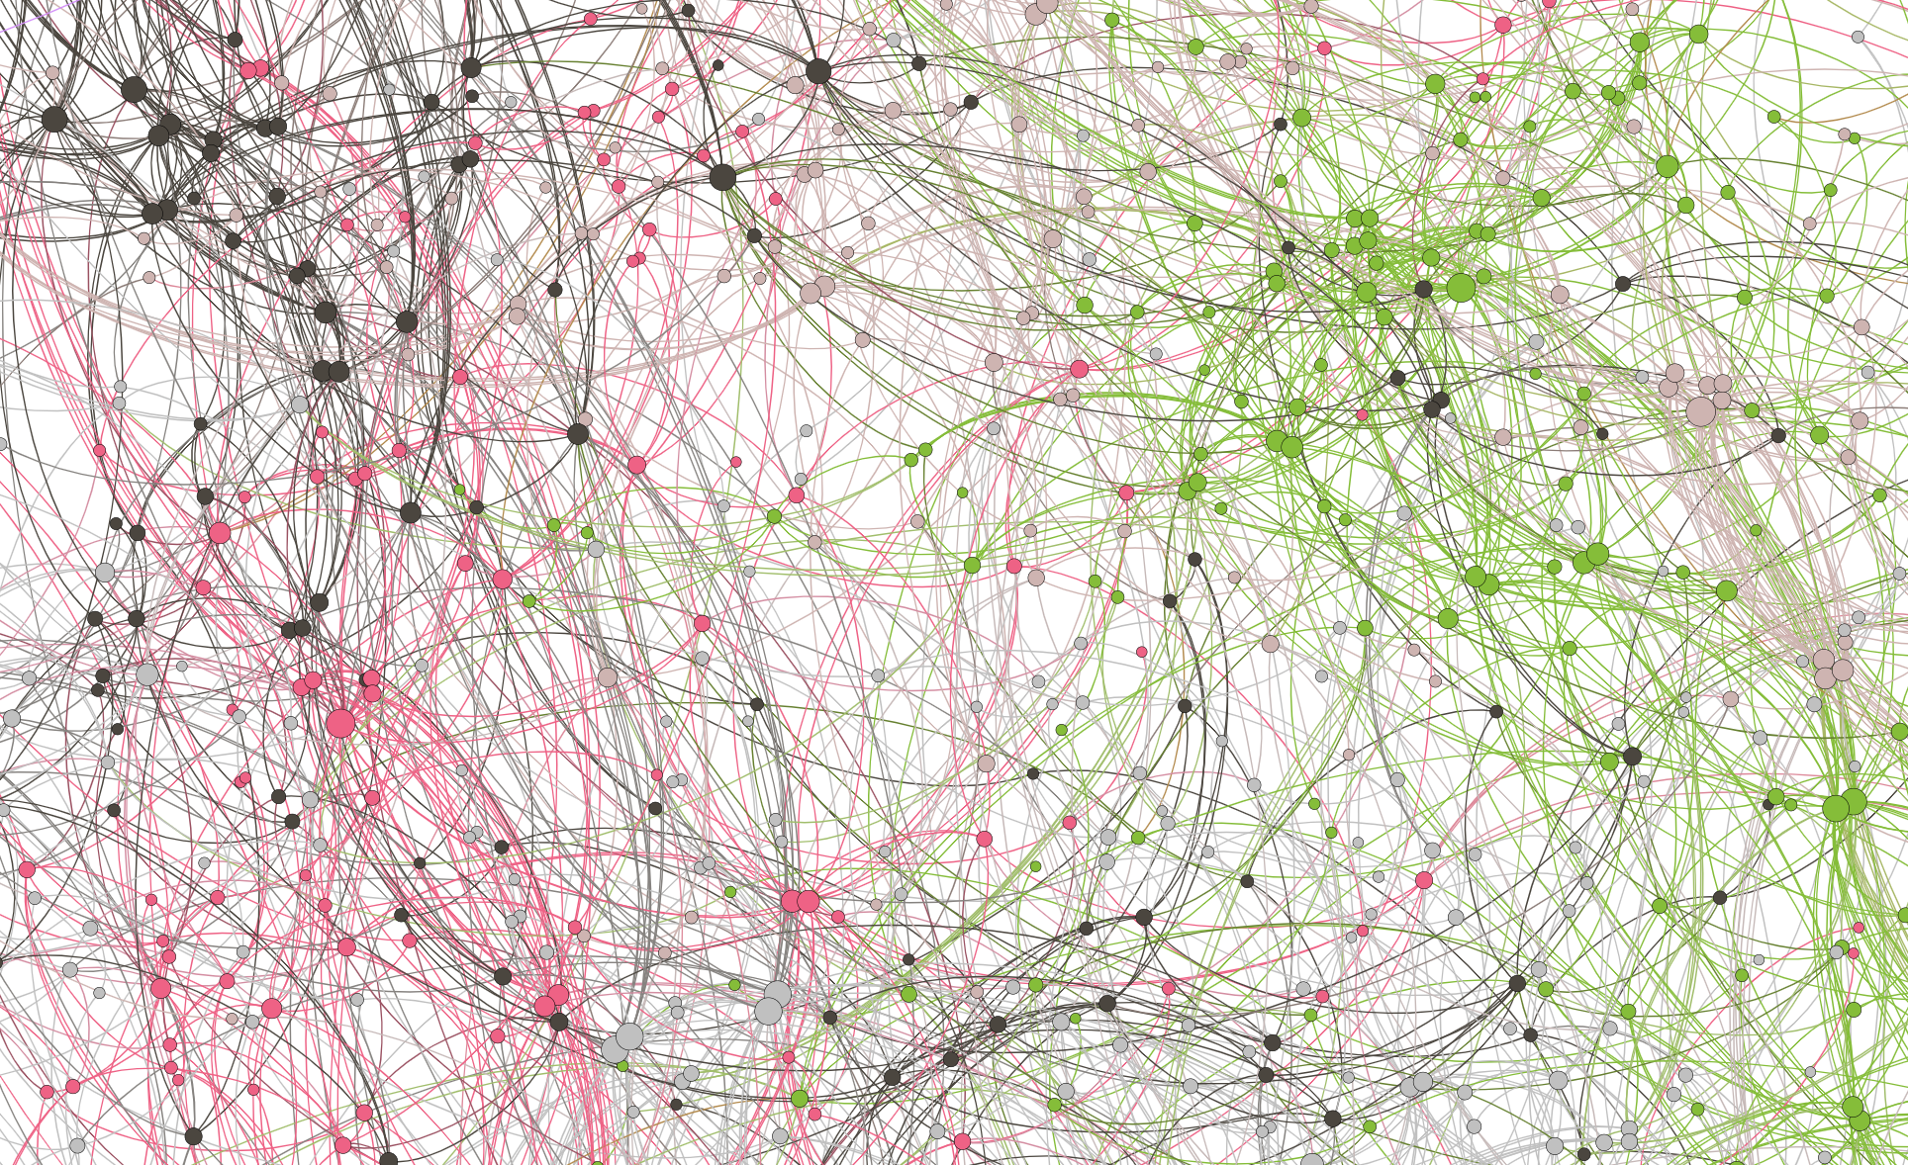
Topology of the 7-pitch class sets in the 24TET space
Classification based on distances between IVs
Nodes are connected for distances up to 2

